Slide 1

Java + Mobile course by Enered

Slide 2
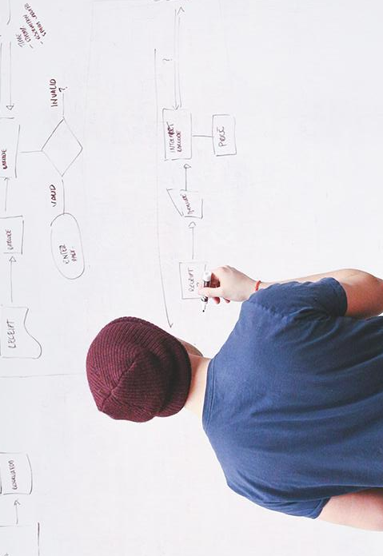
HELLO!
I am Vlad Butnaru
I will be your trainer for this Java session!
PS: It’ll be awesome!

Slide 3
What will we do today
A full game with AI written in Java

Slide 4
Project description
We want to build an app that will help a mouse get to the cheese while avoiding the obstacles

Slide 5
Project architecture (Classes)
Main
Mouse
Cheese
Map
Engine

Slide 6
Main
Will be the entry point to our application
It should create a new Map and pass it to the Engine

Slide 7
Mouse
Variables: x,y (position)
Methods:
canMoveLeft, Right, Up, Down (Map)
moveLeft, Right, Up, Down (Map)
Find (Map) – will get the initial position
If the mouse moves left or right, we replace the previous position with “-”, and if he moves up or down, we replace with “|”

Slide 8
Cheese
Variables: x,y (position)
Methods:
isFound (Map) – will return true if the mouse got to the cheese
Find (map) – will get the initial position

Slide 9
Map
Variables: bidimensional char array of 15/15
Mouse is represented by ‘m’
Cheese is represented by ‘c’
Obstacles are represented by ‘x’
Clear paths are represented by “o”

Slide 10
Engine
Variables: Map, Mouse, Cheese;
Based on the map received from Main, it should contain a method that moves the mouse to the cheese.
Another method should output the resulted Map with the mouse trail.

Slide 11
Let’s get to work!

Slide 12
THANKS!
Any questions?
You can find me at:
@web: http://vladbutnaru.com/
@facebook· Vladut Butnaru
@linkedin· Vlad Butnaru
@email : vlad2me@gmail.com
@phone : +40 0754 827 620

Slide 13
Feedback please!
http://bit.do/feedbackvlad

